Slide 1

JAVA LDAP
Dima Ionut Daniel

Slide 2

Contents
What is LDAP?
LDAP Operations
Directory Service
JNDI as LDAP API
Pooling
Spring LDAP
UnboundId LDAP SDK
JAVA LDAP frameworks
Conclusion
Bibliography

Slide 3

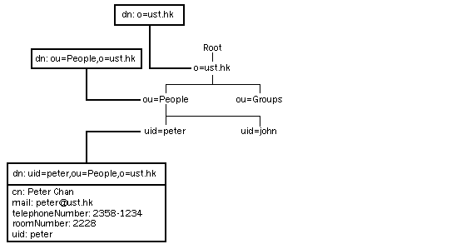
What is LDAP?
LDAP(The Lightweight Directory Access Protocol) is an Internet standard protocol used by applications to access information in a directory. It runs directly over TCP, and can be used to access a standalone LDAP directory service. LDAP is based on a client-server model. LDAP is defined in terms of ASN.1 and transmitted using BER.
Abstract Syntax Notation One (ASN.1) is a standard and flexible notation that describes rules and structures for representing, encoding, transmitting, and decoding data in telecommunications and computer networking.
The Basic Encoding Rules (BER) is one of the encoding formats defined as part of the ASN.1 standard specified by the International Telecommunication Union (ITU )in X.690.
The LDAP directory service model is based on entries. An entry is a collection of attributes that describing it. Each attribute has a name, type and one or more values.
In LDAP, directory entries are arranged in a hierarchical tree-like structure, starting at a root and then branching down into individual entries. Each entry is uniquely identified by a distinguished name. A distinguished name consists of a name that uniquely identifies the entry at that hierarchical level.

Slide 4
What is LDAP?
Request for Comments (RFC) is a memorandum published by the Internet Engineering Task Force (IETF) describing methods, behaviors, research, or innovations applicable to the working of the Internet and Internet-connected system.
Useful LDAP RFCs:
RFC 2251: "Lightweight Directory Access Protocol (v3)“ → This is the main RFC for LDAPv3, which defines the protocol operations, data representation, and data organization.
RFC 2252: "Lightweight Directory Access Protocol (v3): Attribute Syntax Definitions“ → defines the standard attribute type representations and specifies how attribute values are compared for each standard type during a search operation.
RFC 2253: "Lightweight Directory Access Protocol (v3): UTF-8 String Representation of
Distinguished Names“ → defines the syntax and structure of DN names.
RFC 2254: "The String Representation of LDAP Search Filters“ .
RFC 2255: "The LDAP URL Format" → defines the URL format for expressing an LDAP search. We can enter an LDAP URL in many browsers to perform an LDAP search.
RFC 2589: "LDAPv3 Extensions for Dynamic Directory Services” →defines extended operations to support dynamic (short-lived) directory data storage.

Slide 5
LDAP Operations
LDAP is based on a client-server model. An LDAP client can perform these operations, among others:
- searching and retrieving entries from the directory
- adding new entries in the directory
- updating entries in the directory
- deleting entries in the directory
- renaming entries in the directory
- performing extended requests
To perform any of these LDAP operations, an LDAP client needs to establish a connection with an LDAP server. The LDAP protocol specifies the use of TCP/IP port number 389, although servers may run on other ports.
The LDAP protocol also defines a simple method for authentication. LDAP servers can be set up to restrict permissions to the directory. Before an LDAP client can perform an operation on an LDAP server, the client must authenticate itself to the server by supplying a distinguished name and password. If the user identified by the distinguished name does not have permission to perform the operation, the server does not execute the operation.

Slide 6
Directory Service
A directory service is the software system that stores, organizes and provides access to information in a directory. It allows the lookup of values given a name, similar to a dictionary.
As a word in a dictionary may have multiple definitions, in a directory, a name may be associated with multiple, different pieces of information.
Open Source implementations:
OpenDS
389 Directory Server
ApacheDS
OpenLDAP
Commercial implementations:
Red Hat Directory Server
UnboundID Directory Server
IBM Tivoli Directory Server
Oracle Internet Directory

Slide 7
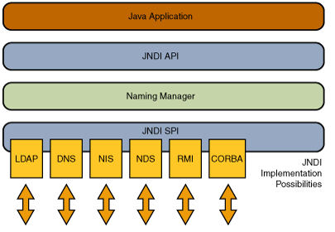
JNDI as LDAP API
JNDI(Java Naming and Directory Interface) an API to access the directory and naming services.
The association of a name with an object is called a binding. An LDAP name is bound to an LDAP entry.
A context is a set of name-to-object bindings.
A name in one context object can be bound to another context object (called a subcontext) that has the same naming convention.
The JNDI architecture consists of an API and a Service Provider Interface (SPI).
The SPI enables a variety of naming and directory services to be plugged in transparently.

Slide 8
JNDI as LDAP API
JNDI is included in the Java SE Platform. The JDK includes service providers for the following naming/directory services:
-Lightweight Directory Access Protocol (LDAP)
- Common Object Request Broker Architecture (CORBA) Common Object Services (COS) name service
-Java Remote Method Invocation (RMI) Registry
-Domain Name Service (DNS)
The JNDI is divided into five packages:
-javax.naming
-javax.naming.directory
-javax.naming.ldap
-javax.naming.event
-javax.naming.spi

Slide 9
JNDI as LDAP API
JNDI useful classes for working with LDAP:
javax.naming.InitialContext →starting context for performing naming operations.
javax.naming.ldap.LdapContext → context in which we can perform operations with LDAPv3 and also perform LDAP extended operations.
javax.naming.directory.DirContext → contains methods for examining and updating attributes associated with objects and for searching the directory.
javax.naming.directory.SearchControls → encapsulates information for performing search operation
javax.naming.directory.SearchResult → result returned from dap search operation.
javax.naming.directory.Attribute → atribut asociat unui obiect JNDI
javax.naming.directory.Attributes → collection of attributes
javax.naming.Context → reprezinta un context de binding-uri.

Slide 10
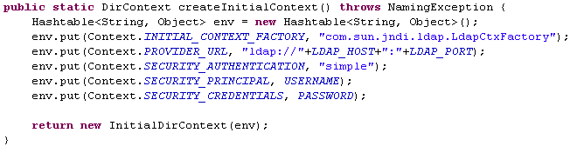
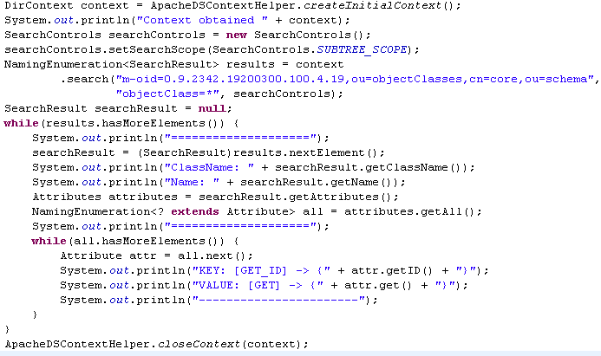
JNDI as LDAP API

Slide 11
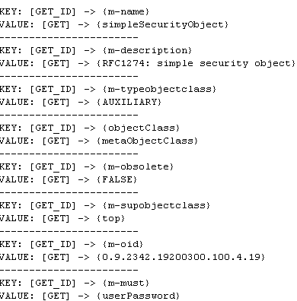
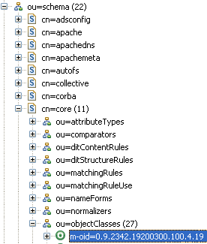
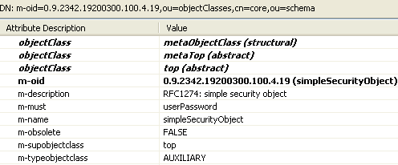
JNDI as LDAP API

Slide 12
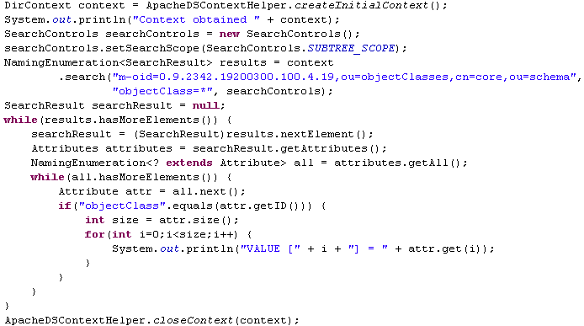

JNDI as LDAP API
This example shows how search from the Directory Server attributes that have multiple values.

Slide 13
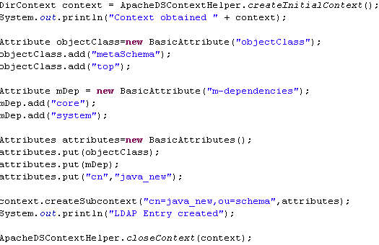
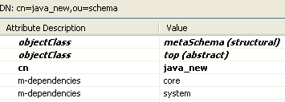
JNDI as LDAP API
This example shows how to create an entry into the Directory Server using JNDI.

Slide 14
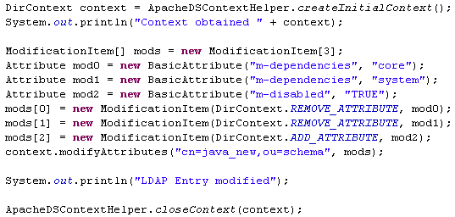
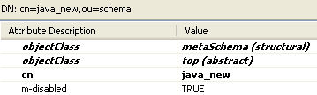
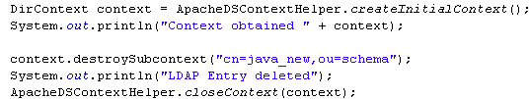
JNDI as LDAP API
This example shows how to modify an entry from the Directory Server using JNDI.
This example shows how to delete an entry from the Directory Server using JNDI.

Slide 15
Pooling
Connection pooling is configured and maintained per Java runtime. To use connection pooling, no configuration is required.
We configure connection pooling by using a number of system properties at program startup time. These are system properties, not environment properties and that they affect all connection pooling requests.
System properties for configuring connection pooling:
com.sun.jndi.ldap.connect.pool.authentication → a list of space-separated authentication types of connections that may be pooled. Valid types are "none", "simple", and "DIGEST-MD5".
com.sun.jndi.ldap.connect.pool.debug → debug levels: "fine" (trace connection creation and removal) and "all" (all debugging information).
com.sun.jndi.ldap.connect.pool.initsize → the number of connections per connection identity to create when initially creating a connection for the identity.
com.sun.jndi.ldap.connect.pool.maxsize → the maximum number of connections per connection identity that can be maintained concurrently.
com.sun.jndi.ldap.connect.pool.prefsize → the preferred number of connections per connection identity that should be maintained concurrently.
com.sun.jndi.ldap.connect.pool.protocol → protocol types of connections that may be pooled. Valid types are "plain" and "ssl".
com.sun.jndi.ldap.connect.pool.timeout → the number of milliseconds that an idle connection may remain in the pool without being closed and removed from the pool.
com.sun.jndi.ldap.connect.pool → enables connection pooling

Slide 16
Pooling
When we request a Context instance the connection that is used might of might not be pooled based on the "com.sun.jndi.ldap.connect.pool" environment property.
The LDAP provider needs to determine whether the request can be satisfied by an existing pooled connection.
There are three sizes that affect the management of each pool. These sizes are global and affect all pools.
By default, the initial pool size is 1 and can be changed by using the system property "com.sun.jndi.ldap.connect.pool.initsize".
When the pool size reaches the maximum and all of the connections in the pool are in use, the application's request for a connection from that pool is blocked until a connection in the pool either becomes idle or is removed.
A maximum pool size of 0 means that there is no maximum size. A request for a pooled connection will use an existing pooled idle connection or a newly created pooled connection.
By default, idle connections remain in the pool indefinitely until they are garbage-collected.
If the "com.sun.jndi.ldap.connect.pool.timeout" system property has been set, the LDAP provider will automatically close and remove pooled connections that have been idle for more than the specified period.

Slide 17
Spring LDAP
The Spring Framework is an open source application framework and Inversion of Control container for the Java platform.
Inversion of Control (IoC) is a programming design pattern that specifies a layer of abstraction between components. Components link together through public interfaces in a plug-in architecture, they are then stitched together in a factory. Because the control over object instantiation and linking is external, this is termed “Inversion of Control”.
Spring LDAP (http://www.springframework.org/ldap) is a library for simpler LDAP programming in Java.
It completely eliminates the need to worry about creating and closing LdapContext and looping through NamingEnumeration.
It provides classes for dynamically building LDAP filters and DNs (Distinguished Names), LDAP attribute
management, and client-side LDAP transaction management.

Slide 18
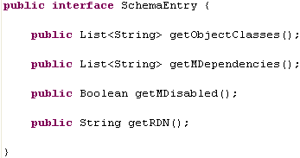
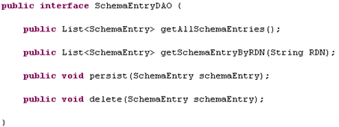
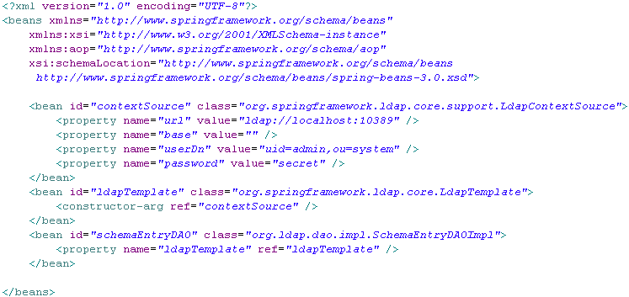
Spring LDAP

Slide 19
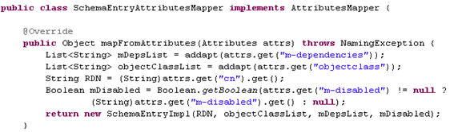
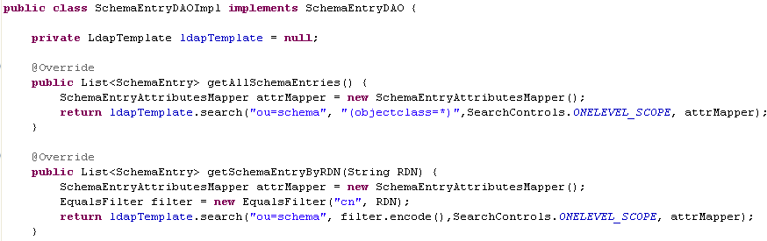
Spring LDAP
This example shows how search from the Directory Server using Spring LDAP.

Slide 20
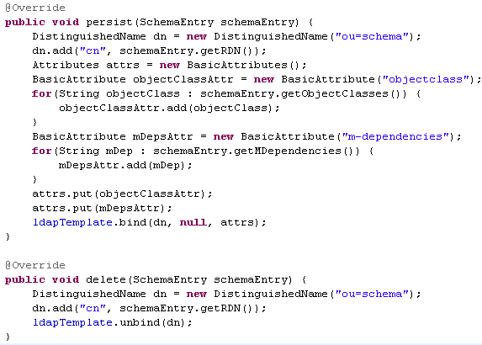
Spring LDAP
This example shows how to create and delete an entry into the Directory Server using Spring LDAP.

Slide 21
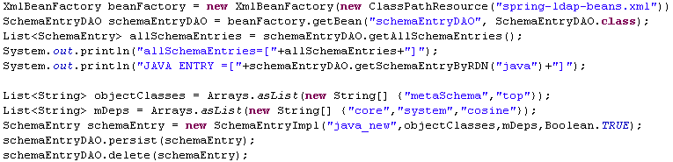
Spring LDAP

Slide 22
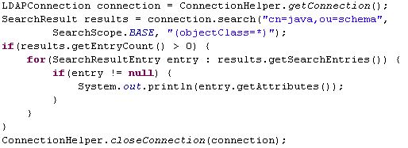
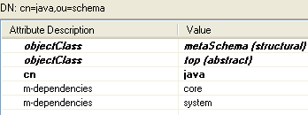
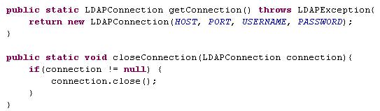
UnboundId LDAP SDK
The UnboundID LDAP SDK is a pure Java 100% implementation, with no dependencies.
It provides support for synchronous and asynchronous operations, with pooling features, load balancing, etc.
The LDAP SDK source code is marked with annotations that help developers understand how it is intended to be used: @ThreadSafety, @Extensible, @NotExtensible,@Mutable, @NotMutable,@InternalUseOnly.
LDAP also offers: ASN.1 encoding / decoding, Connect and disconnect, LDIF reading and writing, LDAP communication, Directory Server monitor data access, Exceptions caught.
This example shows how search from the Apache Directory Server.

Slide 23
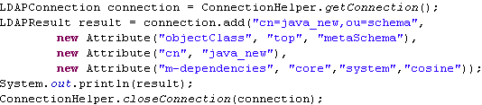
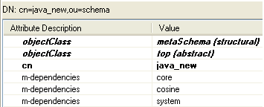

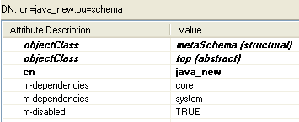

UnboundId LDAP SDK
This examples shows the add, modify and delete operations.

Slide 24
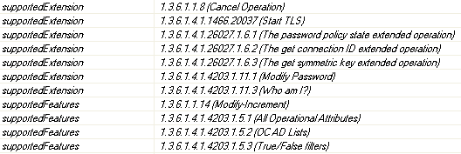
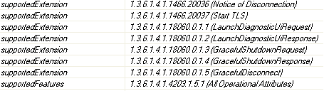

UnboundId LDAP SDK
The UnboundID LDA SDK provides easy use of LDAP extended requests.
The Extended Operation is a generic LDAP operation that can define new operations that were not part of the original protocol specification.
Common extended operations: StartTLS, Abandon, Modify Password, Who am I?
Open DS support for extended requests
Apache DS support for extended requests

Slide 25
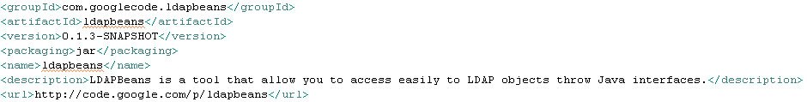
JAVA LDAP frameworks
The LDAPBeans project provided mapping between java interfaces and LDAP attributes. LDAPBeans is a tool that allows easy access to LDAP objects throw Java interfaces. We declare java interfaces describing LDAP objects without having to write the implementation of our beans.
Features:
Primitive type mapping
Complex mapping using regular expressions
Mapping to other LdapBean object
LDAP directory access cache

Slide 26
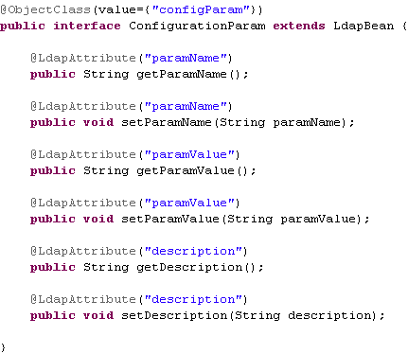
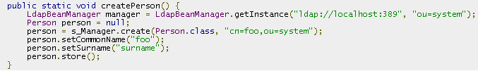
JAVA LDAP frameworks
LdapBeanManager is used as utility class that can create java proxy objects based on the interface declared. It’s also responsible for working with the internal ldap connection pool and doing the cleanup process.

Slide 27
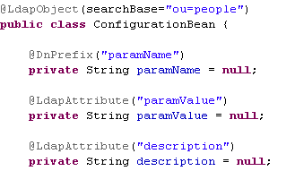

JAVA LDAP frameworks
The object-ldap-mapping Project provides a mapping between java POJO classes and LDAP attributes in a JPA similar way.
Annotations used from the library: LdapObject, DnPrefix, LdapAttribute.
It depends on Spring Ldap library.

Slide 28
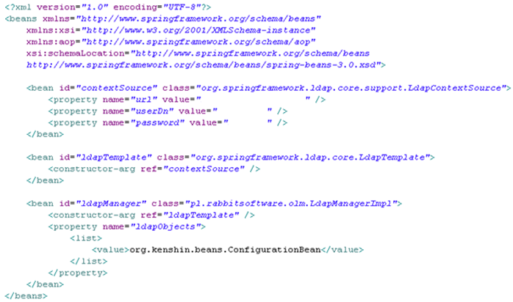
JAVA LDAP frameworks
Beans.xml spring context file needed for creating a LdapManager object.

Slide 29
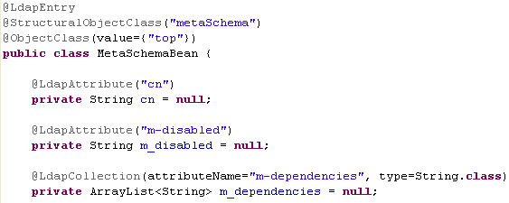
JAVA LDAP frameworks
LDAP-ODM is a framework for mapping LDAP directory entries to Java objects. It uses Spring 2.0, Spring-Ldap 1.1 and CGLib 2.0 to provide object-oriented access to LDAP directory entries.
Features:
LDAP metadata at class-level annotations
Caching of mapped objects
Collections support
Loading objects by DN and query via standard LDAP query.

Slide 30
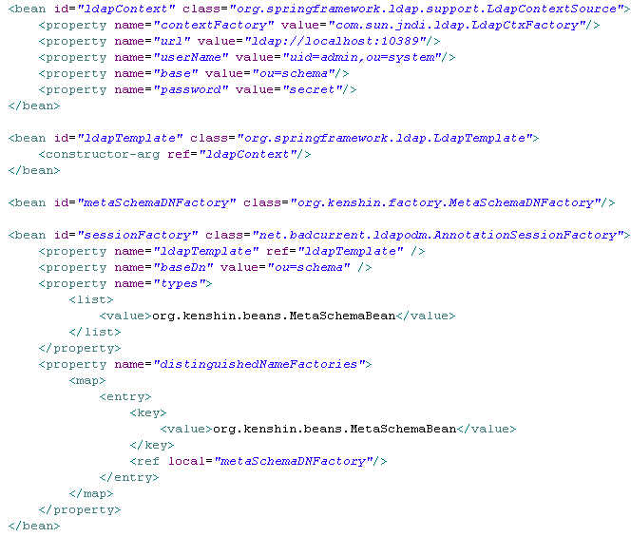
JAVA LDAP frameworks
The entry point for working with LDAP entry object-oriented is the SessionFactory class.

Slide 31
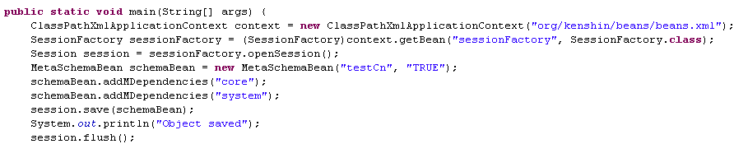
JAVA LDAP frameworks
After obtaining the Session object we can create, modify, find ldap entries.

Slide 32

Conclusion
The advantage of using JAVA with LDAP is that is fast, powerful.
LDAP is used for authentication, very fast data retrieval.
LDAP is hierarchical, simplier.

Slide 33
Bibliography
http://www.ust.hk/itsc/ldap/understand.html
http://en.wikipedia.org/wiki/Lightweight_Directory_Access_Protocol
http://en.wikipedia.org/wiki/Directory_service
http://docs.oracle.com/javase/tutorial/jndi/overview/index.html
JDK API
http://www.unboundid.com/products/ldap-sdk/

